Slide 1
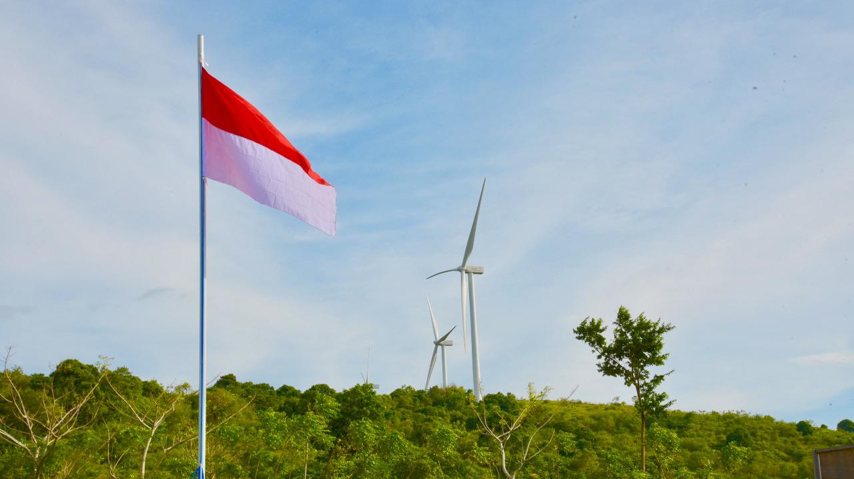

COORDINATING MINISTRY FOR ECONOMIC AFFAIRS
THE REPUBLIC OF INDONESIA
The Role of New, Renewable and Clean Energy in Achieving SDG7:
Policy, Investment, and Technology
Jakarta, 13 November 2019

Slide 2
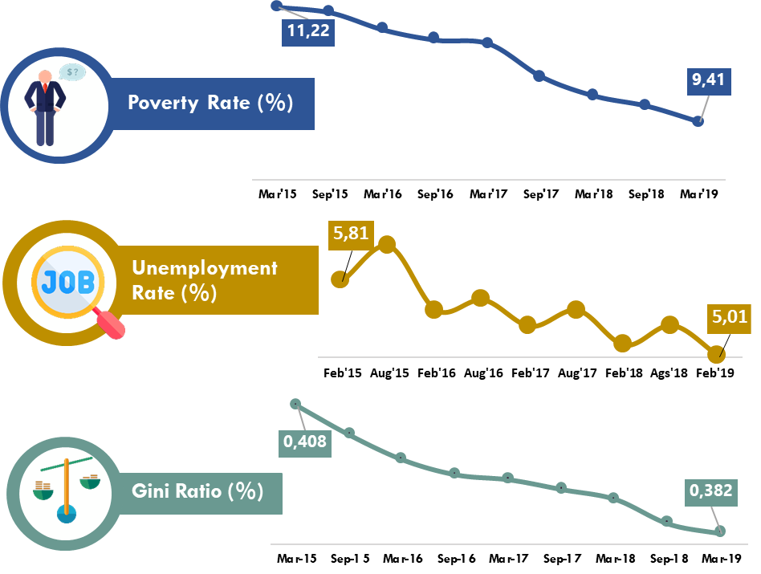
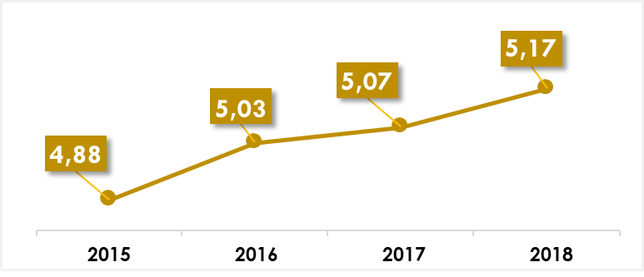
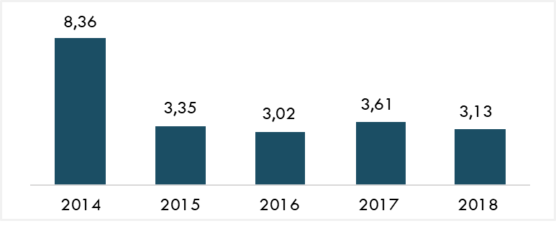
INDONESIA ECONOMIC OVERVIEW
1
DESPITE THE GLOBAL ECONOMIC UNCERTAINTY, INDONESIAN ECONOMIC GROWTH CONSTANTLY INCREASED
3
DECREASED LEVEL OF POVERTY RATE, UNEMPLOYMENT RATE AND GINI RATIO
Economic Growth
2
LOW YET CONTROLLED INFLATION RATE AS TARGETED IN STATE BUDGET
Inflation Rate

Slide 3
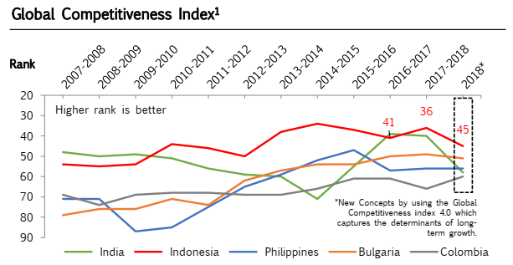
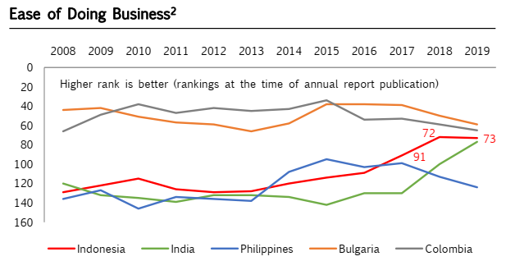
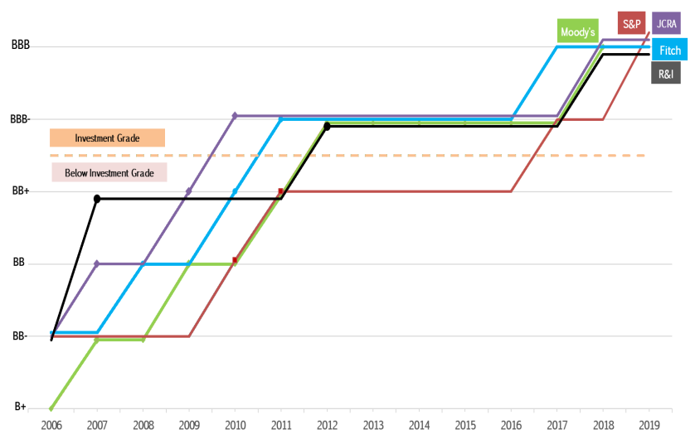
CONTINUOUS IMPROVEMENT ON INVESTMENT CLIMATE
109
Source: World Economic Forum – The Global Competitiveness Report 2018;
Source: World Bank – Doing Business 2019 Report;
Source: World Bank, Investor Relations Unit Republic of Indonesia

Slide 4




INVESTMENT CLIMATE IMPROVEMENT THROUGH “ONLINE SINGLE SUBMISSION”
OBJECTIVES
OPERATION
Providing ease of business licensing
Providing legal certainty for investors
Increasing both domestic and foreign investment
Improving industry and export performance
Creating jobs
Officially launched in July 9, 2018; involving 25 Government Institutions, 34 Provinces, 514 Cities, 12 Special Economic Zones, 4 Free Trade Zones and 87 Industrial Zones
The operation is supported by the local system of the Directorate General (DG) of General Legal Administration, the DG of Civil Registration, the DG of Taxation, the DG of Customs and Excise, the Investment Coordinating Board, the Ministry of Trade, the Indonesia National Single Window, the Ministry of Agriculture, and the Ministry of Public Works and Public Housing
LICENSING CONCEPT
IMPLEMENTATION
Using one national portal, one business license (NIB), and one business permit format (Business License and Operational / Commercial License);
Business Licensing is issued based on Commitments that must be fulfilled by Business Actors;
Fulfillment of commitments is completed in related institutions and/or local government.
To date, businesses have been simplified by OSS:
187,706 (45%) private and 231,378 (55%) non-private businesses
381,686 (95%) domestic and 20,783 (5%) foreign investment
158,802 (38%) Medium-Large Enterprises and 260,293 (62%) Micro, Small and Medium Enterprises
4

Slide 5
INDONESIA AND CLIMATE CHANGE
As a the large GHG emitters, Indonesia plays an important role in meeting the international goal of keeping the global temperature rise to 2°C above pre‑industrial levels.
Indonesia’s GHG emissions, including land use, land‑use change and forestry (LULUCF), have risen by 42% since the turn of the century and are projected to grow even faster over the next 15 years under a business-as-usual (BAU) scenario (MoEF).
This increase was driven by rising emissions from the energy and land‑use sectors. Land‑based emissions, mostly from forest and peat fires, account for nearly half of total GHG emissions.
The government has reported that Indonesia is on track to meet its 2030 target. Forestry and energy sector are the key sectors to achieve the target
GLOBAL COMMITMENT
Target of Paris Agreement:
To keep global temperature rise below 2ºC, and strive to reach 1.5ºC
NATIONAL COMMITMENT
The mandate of Law No. 16 of 2016 on the Ratification of the Paris Agreement to Reduce GHG emissions according to NDC by 2030:
29% from BaU (National Effort)
41% from BaU (International Support)
29% from BaU (National Effort)
41% from BaU (International Support)
Energy
Waste
IPPU
Agriculture
Forestry
11%
0.38%
0.10%
0.32%
17.2%
Energy
Waste
IPPU
Agriculture
Forestry
14%
1%
0.11%
0.13%
23%

Slide 6

INDONESIA ENERGY POLICY
Availability of energy to meet the national demand
Priority of energy development
Utilization of national energy resources
National energy reserves
Main Policies
24%
31%
2050
1,000 MTOE
22%
23%
25%
20%
2025
400 MTOE
30%
25%
18%
5%
Energy conservation, conservation of energy resources and diversification of energy
Environment safety
Pricing, subsidy, and energy incentives
Infrastructure and access to energy and energy industry for the public
Research, development, and application of energy technology
Institutional and funding matters
2050
Supporting Policies
2013
194 MTOE _{46%}
31%
Power Plant: 430 GW
Energy consumption: 3.2 TOE /cap
2025
Electricity consumption: 7,000 KWh/cap
Power Plant: 115 GW
Energy consumption: 1.4 TOE /cap Electricity consumption: 2,500 KWh / cap Electrification ratio (2020): closely to 100%
2013
Power plant: 51 GW
Energy consumption: 0.8 TOE /cap Electricity consumption: 776 KWh /cap Electrification ratio: 80.51%
New and Renewable Energy Oil
Natural Gas Coal
Source: National Energy Council, 2015

Slide 7
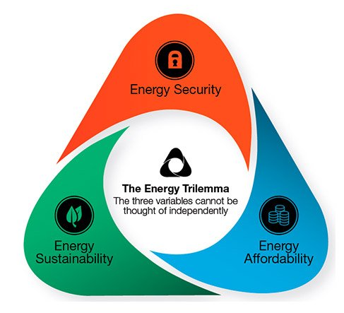
INDONESIA’S ENERGY TRILEMMA
In managing Indonesia’s energy utilization, especially the electricity, the Government holds the principle of the energy trilemma, that the efforts must be carried out in a balanced manner among the three aspects, namely Energy Security, Energy Equity, and Environment Sustainability, without any single one being prioritized.
National Electricity Sustainability
Increase Accessbility/ Electrification Ratio
Additional Capacity
Affordable Electricity Price
Increase Acceptability (reliability, quality and eco-friendly
Source: DG Electricity, MEMR

Slide 8
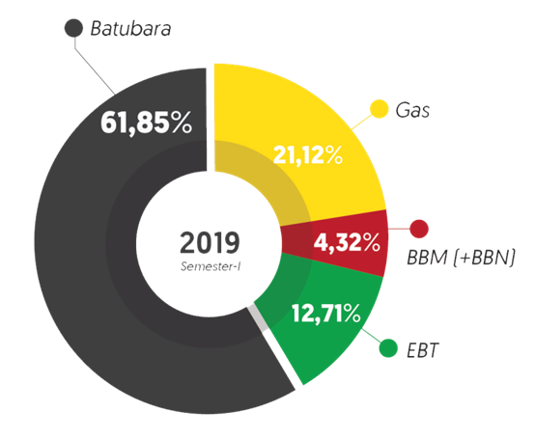
ELECTRICITY SUPPLY PROJECTION AND TARGET TO 2025
Technocratic Plan of National Medium Term Development Plan (RPJMN) 2020 – 2024
Goal | Indicator | Target 2020 | Target 2024
Energy needs’ fulfillment energy by prioritizing the implementation of renewable energy (RE) | RE portion in National Energy Mix | 13,4% | 20%
 | Installed capacity of RE power plants | 14,5 GW | 37,3 GW
 | Domestic components level in RE power plants | 30% | 40%
Increasing the quantity / availability of water to support economic growth | Utilization of dams for electrical functions | 670 MW | 820 MW
Increase in National Electricity Consumption per Capita to 1,500 kWh / capita
National General Electricity Plan 2019 – 2038, Supply Projection 2025
RE portion of 24% (without conservation) and 22% (with conservation)
Electricity consumption per capita is 1,616 KWh / capita
National Energy Policy (KEN) and National General Energy Plan (RUEN) 2025
No. | Goal | Unit | 2020 | 2024 | 2025
1. | Primary energy provision | MTOE |  |  | >400
2. | Energy mix target RE Oil Coal Gas | % % % % |  |  | >23 <25 >30 >22
3. | Power plant provision | GW |  |  | >115
4. | Electrification ratio | % | 85 | 100
5. | Primary energy supply per capita | TOE |  |  | 1,4
6. | Electricity consumption per capita | kWh |  |  | 2.500
How to reach RE goals and target in 2025?
2025
2019
(12.7)
GAP
PRIVATE PARTICIPATION AND INVESTMENT

Slide 9
INVESTMENT REQUIREMENTS AND CAPACITY BY THE GOVERNMENT AND PT PLN (PERSERO)
PLN ELECTRICITY INFRASTRUCTURE INVESTMENT
INVESTMENT NEEDS ON ELECTRICITY
No. | Infrastructure Type | Investment Needs 2019-2025 (mio USD)
1 | Power Plants | 84
2 | Transmission & Substation | 28
3 | Distribution | 75
Total |  | 187
Source: National General Electricity Plan 2019-2038
Electricity infrastructure investment needs ± Rp. 400.7 trillion per year. On the other hand, the investment realization of PT PLN (Persero) is around Rp.115.8 trillion in 2018, while the state budget allocation for electricity infrastructure is relatively small. Investment capacity by the Government and PLN cannot meet investment needs.
PRIVATE PARTICIPATION
Source: MoF
Source: PT. PLN

Slide 10















BIODIESEL IMPLEMENTATION
Indonesia places a strong focus on development of biofuels. These are expected to account for a quarter of renewables by 2025 under the 23% target. The biodiesel targets are particularly ambitious, with a 30% blending mandate in 2025. In September 2018, the government began requiring all vehicles to use fuel with 20% biodiesel content (previously the blending mandate applied to subsidised transport fuels only). The intent was to reduce petroleum imports, which were increasing the current account deficit, and to cut GHG emissions.
Reducing GHG emissions
Meet commitment to decrease GHG emission 29% by 2030.
Reaching renewable energy target
meet the target 23% contribution of Renewable Energy by 2025.
Energy Security
Improving Energy Security
Reducing fuel import
Maintaining
Trade Balance
Maintaining
CPO price
Enhancing palm oil downstream Industries
Increase the palm oil value added through downstream industry
Foreign exchange savings
Through fuel import reduction

Slide 11

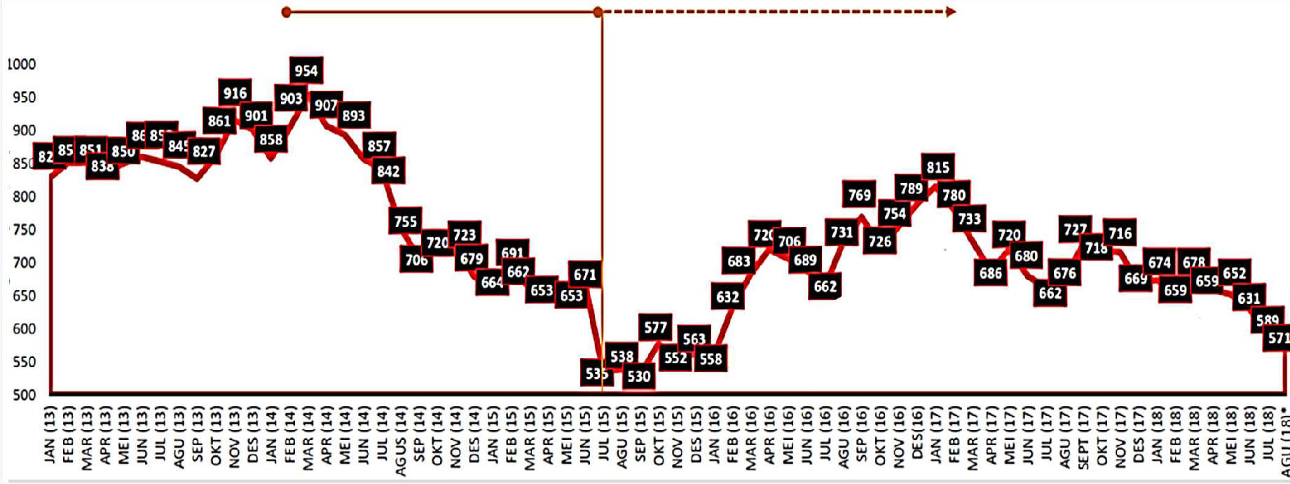
FINANCING BIODIESEL PRICE GAP
Indonesia founded Palm oil Fund Agency (BPDPKS) in 2015 as a solution to finance the gap between biodiesel price and diesel fuel price. This agency manages the oil palm fund collected from the palm oil products exporters and distribute the fund to abate biodiesel price disparity, palm oil research and development, etc.
CPO Over Supply
Palm oil funding starts from July 2015
Harga CPO (US$/Ton)
BPDPKS founded on June 2015
CPO price increase
CPO price remains relatively stable

Slide 12



FINANCING RENEWABLE THROUGH BPDLH
Fund Sources
Institutions
Investment
Disbursement
Example of Disbursement Mechanism
Beneficiaries
Investment: Banking instrumen and other financial instrument
Project Development Facility (PDF)
Pemerintah
Grant
Government
APBN/PNBP
Viability Gap Fund
(VGF)
Central
Grant
1b
Investment Return
Fund
Subsidies
Local
BPDLH
Revolving Fund Facilities
Others Income: interest penalties.
2
3
Management
Order
Loan
Fee
Non- Government
Carbon Sales
Custodian Bank
Carbon Offset Mechanism
LSM/NGO
Carbon Trading
1a
Fund
Private Sector
Grant/ RBP Grant
Guarantee
Koperasi
Others
Investor/ Agencies
Grant Enhancement Equity (GEE)
SOE
Capital/ Equity
Donor
^{Bilateral dan} Pembiayaan/ Swasta Multilateral Donor

Slide 13
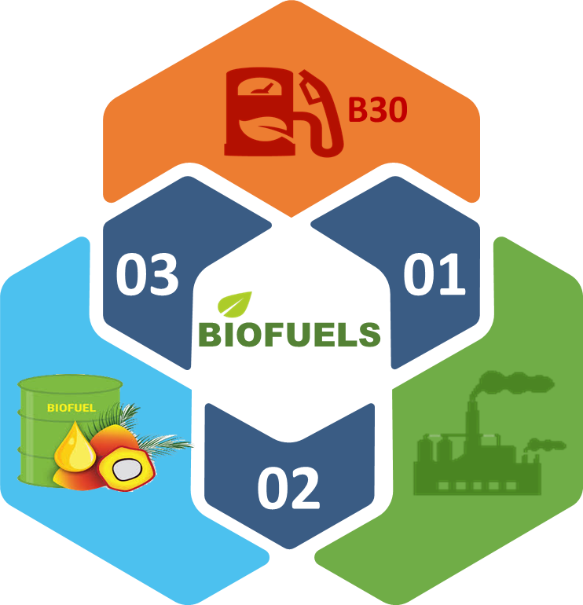
BIODIESEL PROGRESS AND DEVELOPMENT
Strategy & Development For CPO Based Biofuels
B20 in 2019 → B30 in 2020
Under the Ministry of Energy and Mineral Resources Regulation No. 12/2015, by 2020 B30 will be implemented for all sector (PSO and NPSO)
Road Test B30 is currently on progress.
74,17%
CONVERTING PLTD – PLTBn & BUILDING PLTBn
To increase the contribution of New and Renewables in the national energy mix, PT PLN (Persero) will convert the existing PLTD to PLTBn.
The conversion trial begin in the second semester of 2019.
Biodiesel Consumption January to 24 October 2019 reach 4.9 million kL (74,17%) from Total Allocation/ target 2019 by 6.6 million kL.
GREEN fuel/ Bio-hydrocarbon
The Government will start developing CPO-based Green Fuel from 2019 through PT Pertamina’s refineries both by co-processing and stand-alone Refinery Unit.
It is estimated that in 2023 the demand of CPO for Green Fuel will reach 4,9 Million KL/Year

Slide 14
RENEWABLE DEVELOPMENT CHALLENGES
In developing and increase the investment in renewable energy faced a significant challenges.
High Cost of Financing and Low Return of Investment
Price Disparity between Renewable and Fossil Energy
Techonolgy imported is relatively high
Legal and Technical Issues: Take or Pay Clause Agreement, and Intermittent sources of RE
Government involvement in providing incentives / support to support the renewable energy.
Opportunity for the private sector and academicians to be involved and contribute to the renewable industry

Slide 15
THANK YOU
Coordinating Ministry for Economic Affairs
Republic of Indonesia

