Slide 1

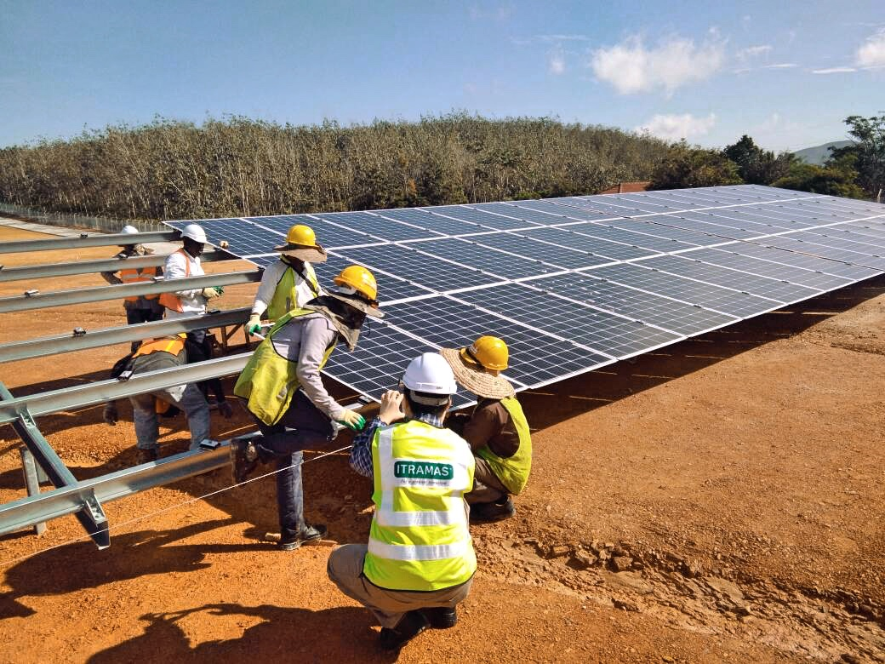

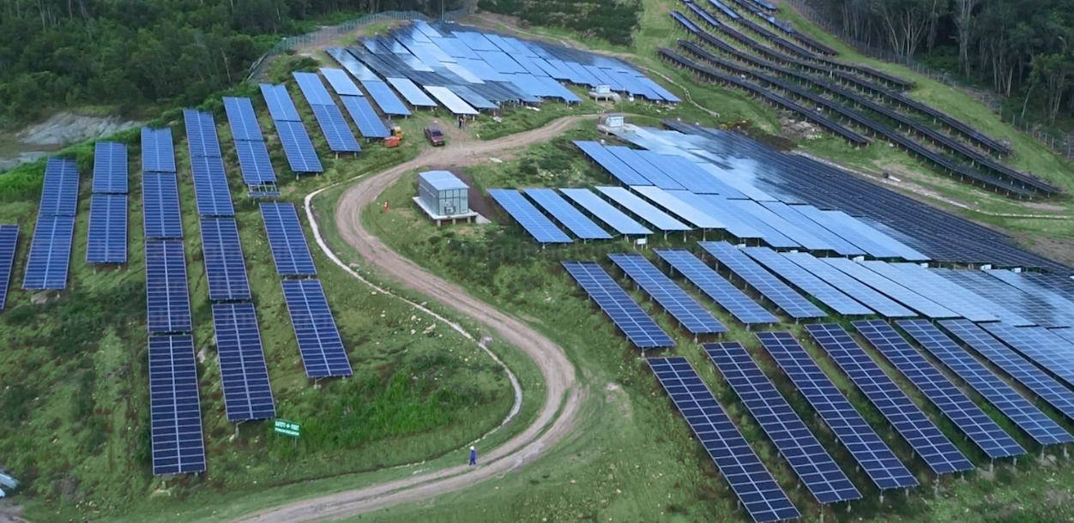
The Role of New, Renewable, and Clean Energy in Achieving SDG7:
Policy, Investment and Technology
Sustainable Finance
M. Rozani Osman
Nov 13, 2019

Slide 2
What is a Green Bond?
Green Bonds are any type of bond instrument where the proceeds will be exclusively applied to finance or re-finance in part or in full new and/or existing eligible Green Projects
For a bond to be green, an issuer must comply with three requirements:
Assign bond proceeds solely for the financing or re-financing of projects to improve or protect the environment
Declare the bond to be green (before issuance)
Commit to a level of transparency and reporting on the bond’s use of proceeds
2

Slide 3
Climate-smart Investments Required
Just in these 3 countries alone….
Indonesia
Investments for low-carbon, resilient ports, rail, roads, estimated at nearly US$20 billion
Construction of new green buildings will require almost US$209 billion
Philippines
New green buildings, waste and transport will see investment of US$57 billion, US$2 billion, and US$41 billion respectively
Vietnam
Transportation infrastructure needs of US$571 billion by 2030
New green buildings represent an almost US$80 billion investment opportunity
Sustainable financial tools such as green bonds, play a key role in attracting investment to environmentally-friendly projects
Source: IFC, World Bank Treasury; Photo credit: QSPM
Notes:
In order to reach the UN Sustainable Development Goals (SDGs) and meet the climate change mitigation targets by 2030, the world faces an investment gap of USD2.5 trillion per year.

Slide 4
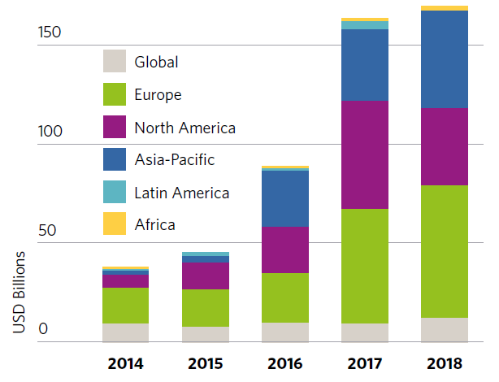
Global Trends in Green Bond issuance (1)
Global Green Bond issuance 2014-2018
Source: Climate Bonds Initiative
4
Notes:
By end of 2018, a total USD1.45 trillion of climate aligned bond issuance currently outstanding which have been issued since 2005.

Slide 5
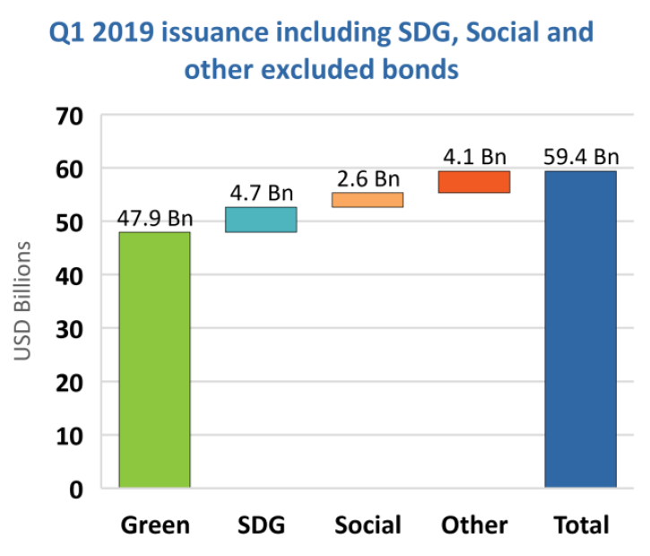
Global Trends in Green Bond issuance (2)
Source: Climate Bonds Initiative
5
Notes:
By end of 2018, a total USD1.45 trillion of climate aligned bond issuance currently outstanding which have been issued since 2005.

Slide 6
Sovereign Green Bonds (1)
Examples:
Fiji - FJD 100m green bond issuance
2016
Nigeria - NGN 10.7bn green bond
Lithuania - EUR 20m green bond
2018
2019
First Emerging Market sovereign green bond
First sovereign green sukuk (Islamic bond)
France - EUR 1.1bn green bond (3rd issue)
First sovereign green bond
Poland - EUR 750m green bond
France - EUR 7bn green bond (1st issue)
Indonesia - USD 1.25bn green sukuk (1st issue)
Indonesia - USD 750m green sukuk (2nd issue)
2017
Largest sovereign green bond issue to date
Source: Climate Bonds Initiative
6

Slide 7
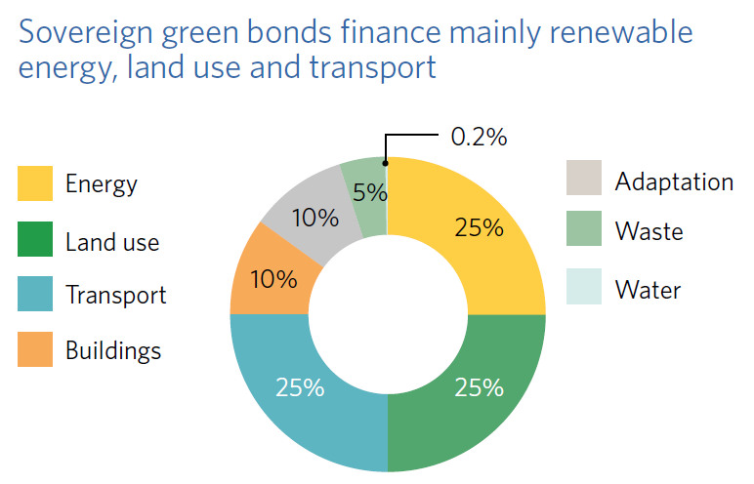
Sovereign Green Bonds (2)
Source: Climate Bonds Initiative
7
Notes:
By end of 2018, a total USD1.45 trillion of climate aligned bond issuance currently outstanding which have been issued since 2005.

Slide 8
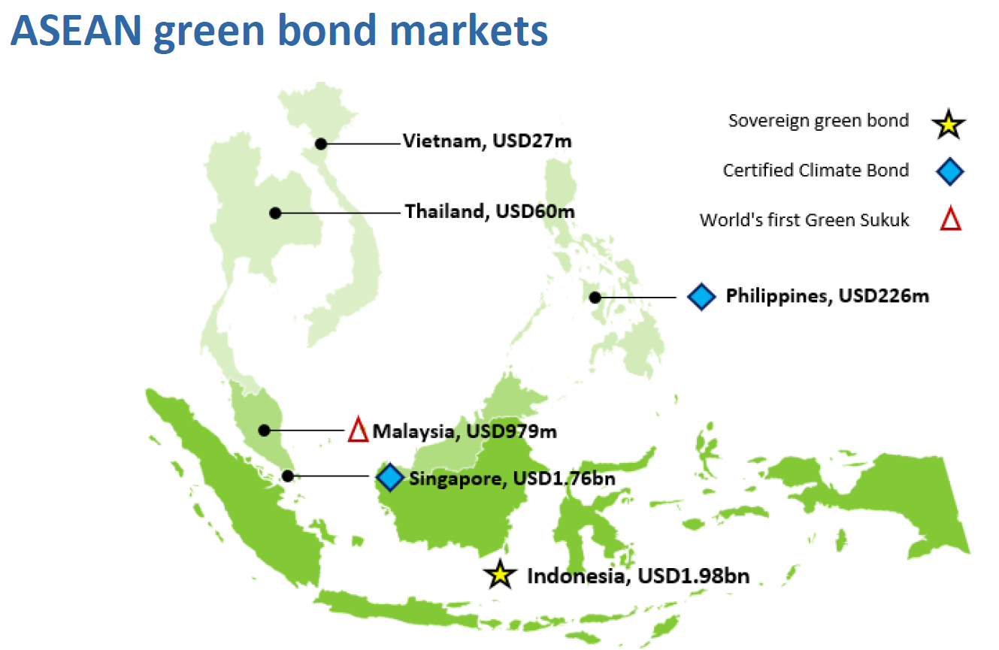
Regional Bond Markets (up to Nov 2018)
Source: Climate Bonds Initiative
8
Notes:
CBI seems to be referring to Vietnam’s issuances as 2 pilot bond issuances by HCMC and Ba Ria Vung Tau in 2016

Slide 9







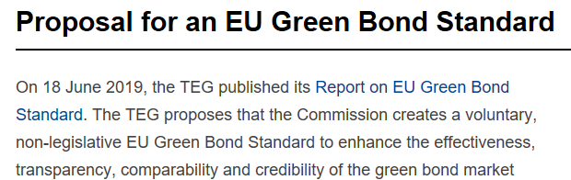
Standards
9

Slide 10
Green Bond Standards – Regional/National
ASEAN Green Bond Standards
Based on the ICMA Green Bond Principles with additional criteria
Must have geographic/economic link to ASEAN region
Excludes fossil fuel power generation projects
Continuous disclosure of information
External review is voluntary
Indonesia Green Bond Regulations
Aligned with ICMA Green Bond Principles
External review is mandatory
Green non-compliance clause
Source: ASEAN Capital Markets Forum, Securities Commission Malaysia, OJK

Slide 11
Additional Steps needed to issue a Green Bond
In addition to the normal issuance process for a Bond, an issuer needs to:
Develop a Green Framework to document the usage of the proceeds from the issuance
For proceeds meant for a general pool of unspecified investments, additional detail on project selection criteria and process are needed
For proceeds meant for a single specified purpose (single project bond), defining the project should be sufficient
Seek an External Review from a third-party on the proposed issuance
CICERO, Climate Bonds Certification, RAM, Moody’s Green Assessment, etc.
Optional step, but investors are increasingly expecting this as the norm
Issuers benefit from a pre-issuance check before facing investors
Impact reporting post-issuance
Optional step, but again, investors are increasingly expecting this
Ring-fencing proceeds from co-mingling with other funds (physically or virtually)

Slide 12
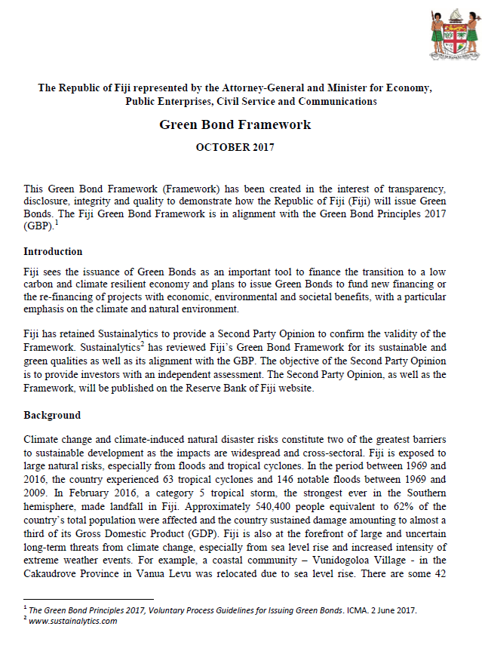
Green Bond Framework
Describes how the Issuer intends to use the proceeds of the green bond issuance, for eligible Green projects in a sustainable manner with appropriate transparency and disclosures to investors
This usually includes:
Use of proceeds
How are the proceeds managed prior to investment?
What are “Eligible Green Projects”
How are the “Eligible Green Projects” selected and evaluated?
Reporting by the Issuer to the Investors on:
Use and management of proceeds
Environmental benefits achieved
Fiji Green Bond Framework
Indonesia Green Bond and Green Sukuk Framework
Source: Reserve Bank of Fiji

Slide 13
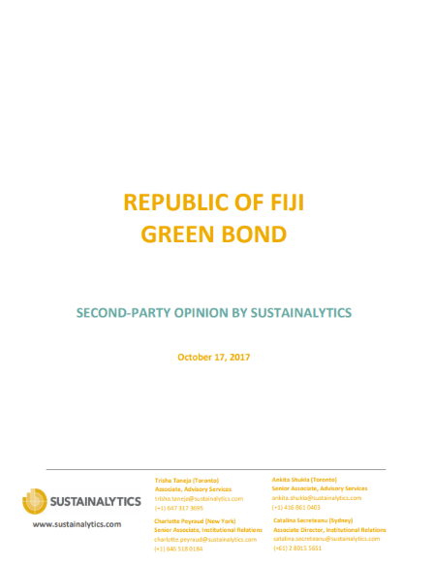
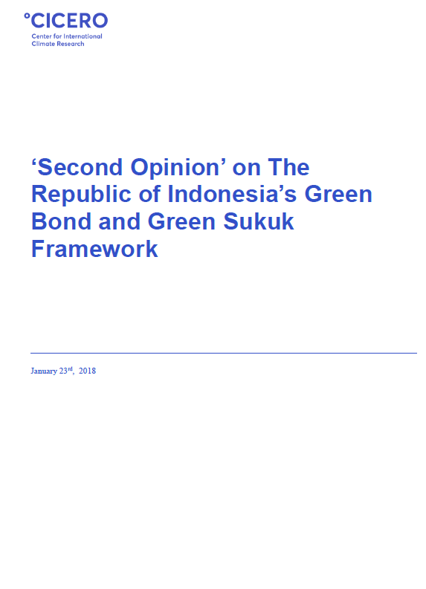
External Review
External Review
More commonly referred to as a Second Opinion
A report by an independent expert assessing the green bond issuance with regard to its alignment with applicable green standards or guidelines, such as the Green Bond Principles, the Climate Bonds Standard, the ASEAN Green Bond Standards, etc.
Some Second Opinions also provide a sustainability rating with a quantitative indication of the analysis (such as CICERO’s Shades of Green, etc.)
Sovereign Green Bond External Reviews
Fiji
Examples of external reviewers include CICERO, Sustainalytics, S&P, Moody’s, etc.
Indonesia
Source: Climate Bonds Initiative, Sustainalytics, MOF Indonesia
Notes:
Domestic vs International reviewers:
A domestic reviewer would know the local regulatory, business and environmental situation better but may lack the international reputation if the domestic green bond market is new or just beginning to grow
An international reviewer would likely have a well-regarded reputation globally but could be less familiar with the local situation

Slide 14
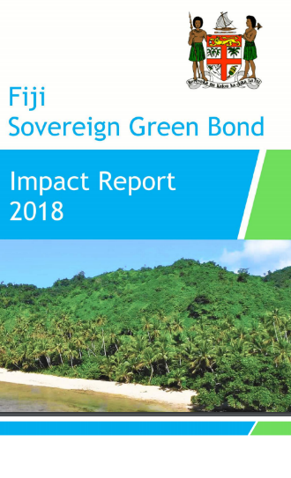
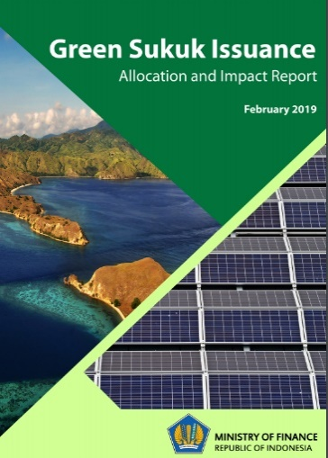
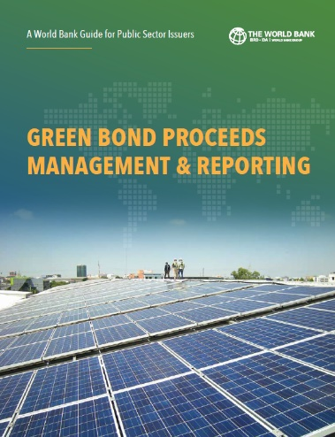
Impact Reporting
What is it and why is it important?
An impact report provides some transparency to the underlying projects that the green bond had financed and it assures investors that the proceeds of the bond issuance has been used appropriately
What is reported?
It is suggested that issuers aim to report on at least a limited number of core indicators for projects included in their green bond programs.
Indonesia
Fiji
Sovereign Green Bond Impact Reports and Guide
Green Bond Proceeds Management and Reporting Guide
Source: WB Treasury Green Bond Impact Report 2017, Reserve Bank of Fiji, SDG Philanthropy
Notes:
For energy efficiency and renewable energy:
Annual energy savings
Annual Green House Gas emission reduced or avoided
Annual renewable energy plants constructed or rehabilitated

Slide 15
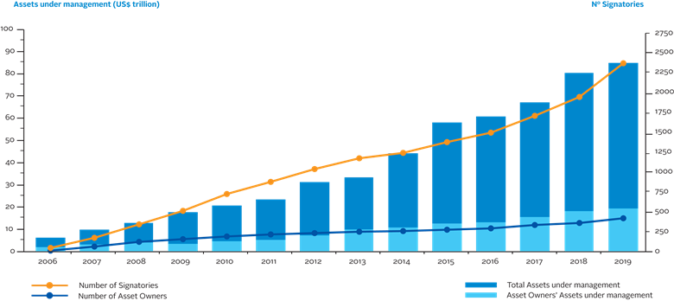
UN Principles of Responsible Investment
2372 signatories
US$86.3 Trillion AUM
Rapid growth in investors seeking sustainable investments
Financial tools must be available to match investors and assets/projects
Sustainable financial instruments serve to bridge responsible investors and sustainable investments
Source: UN PRI

Slide 16


Sovereign Green – Republic of Indonesia (2018)
USD 1.25b green sukuk to finance a pool of eligible green projects (mitigation or adaptation)
Pool of green projects: renewable energy, sustainable transport, waste management, climate-related projects and green buildings
Green Bond Principles, ASEAN Green Bond Standards and Indonesian Green Regulations
Second Opinion by CICERO: Medium Green
Indonesia is rated BBB (Fitch), BBB- (S&P) and Baa3 (Moody’s)
Tenure: 5 years
Issued in Feb 2018
Over 2x oversubscribed, pricing tightened by 30bp to 3.75%
Source: Ministry of Finance Indonesia, CICERO, Trading Economics, Azzad

Slide 17

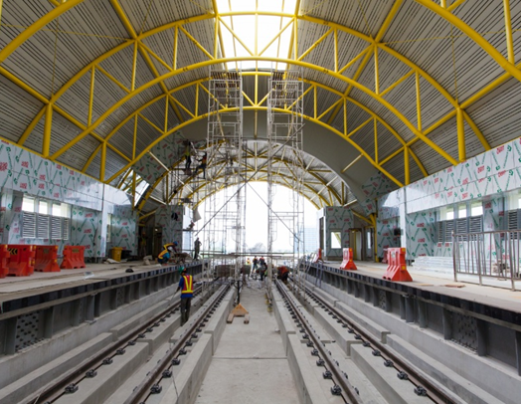

Green Bond – PT SMI (2018)
Total IDR 3 trillion (approx. USD $208 million)
First issuance - IDR 500 billion (approx. USD $35 million) in which IDR251.5bn (3yrs) & IDR 248.5bn (5yrs)
to finance a pool of eligible green projects (mitigation or adaptation)
Pool of green projects: renewable energy, energy efficiency, sustainable pollution management and prevention, sustainable natural resources and land use management, clean transportation, and sustainable water and sewage management
ICMA’s Green Bond Principles, ASEAN Green Bond Standards and Indonesian Green Bond Regulations
Second Opinion by CICERO: Medium Green
Rated id AAA (Pefindo)
Issued in July 2018

Slide 18


Green Building – Segi Astana (2018)
MYR 415m (USD 107m) green bond program to refinance the development cost of a shopping complex integrated with the Kuala Lumpur International Airport (gateway@klia2) in Malaysia
Issued on January 8, 2018
ASEAN Green Bond Standards
Building certified as LEED Silver
Rated AA- by MARC
Second Opinion by RAM Consultancy: Tier-3
First conventional ASEAN Green Bond and first conventional green bond issued in Malaysia
Source: BNM, RAM Consultancy, Segi Astana
18

Slide 19
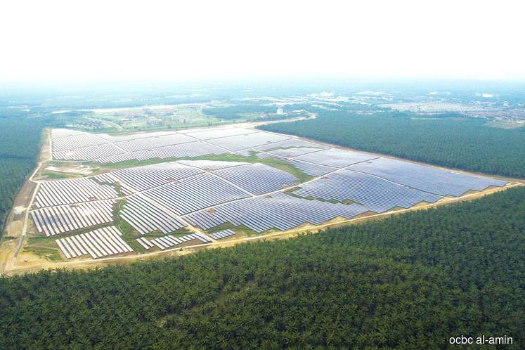

Sustainability Sukuk – Edra Solar (2019)
MYR 245m (USD 59m) sustainability sukuk issuance for the financing of a 50MW solar photovoltaic power plant in Kedah, Malaysia
Social agenda: 40 acres of land surrounding power plant was allocated to the local community for crop farming.
ASEAN (Sustainability Bond Standards, Green Bond Standards, Social Bond Standards), ICMA (Green Bond Principles, Social Bond Principles, Sustainability Bond Guidelines)
Rated AA2 by RAM Ratings
Second Opinion by RAM Consultancy: Tier-1 EB, Tier-3 SB
Edra Sustainability Framework
Source: BNM, OCBC Al-Amin, Edra, Edge
19

Slide 20

Sustainable Finance Instruments
The financial instruments you use today, are just as useful for sustainable financing
Institutional
Bonds/Sukuk
Loans
Investment Funds
Equities
Retail
Retail Bonds/Sukuk
Mortgages
Vehicle Loans for EEV/LEV/PHEV/EV/etc.
Investment Funds
Equities
Crowdfunding
P2P Lending
Green
Social
Sustainable
Blue
SRI
SDG
Climate
ESG
etc.
Finance provides the tools. It’s up to you to use it.

Slide 21




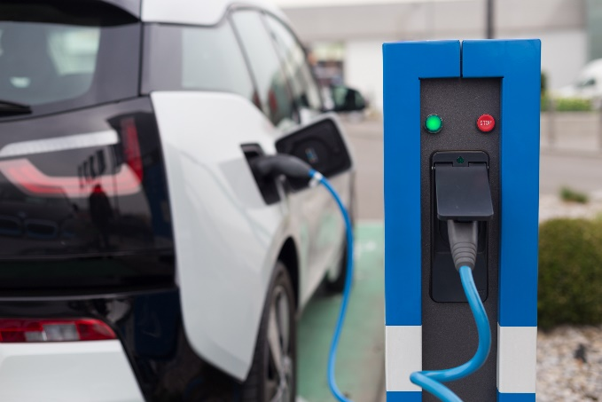



Thank you

Slide 22
Green Bond Standards - Global
Green Bond Principles 2017 (International Capital Markets Association)
Use of Proceeds
Process for Project Evaluation and Selection
Management of Proceeds
Reporting
External review is voluntary
Climate Bond Standards V2.1 (Climate Bonds Initiative)
Fully aligned with Green Bond Principles
Mandatory requirements for use of proceeds, tracking and reporting
Specific eligibility criteria for low carbon and climate resilient projects and assets
Certification Scheme
Source: ICMA, Climate Bonds Initiative

Slide 23

ASEAN Green Bond Standards
Launched on Nov 8, 2017 and endorsed by the ASEAN Capital Markets Forum
Based on International Capital Market Association (ICMA)’s Green Bond Principles (GBP)
Compliant issues may be labeled ASEAN Green Bonds or ASEAN Green Sukuk
Aligned and guided by the 4 core components of the GBP: use of proceeds, process for project evaluation and selection, management of proceeds and reporting
Key additional features:
Eligible Issuers
Must have geographic/economic link to the ASEAN region
Ineligible Projects
Fossil fuel power generation projects are excluded
Continuous Accessibility to Information
Required to disclose to investors: use of proceeds, project evaluation and selection, management of proceeds; and ensure such information is publicly accessible
Encourage More Frequent Reporting
External Review
Voluntary as per GBP
External reviewers required to have relevant expertise and experience, with credentials and scope of review publicly accessible
Source: ASEAN Capital Markets Forum

Slide 24
Publications
What are Green Bonds?
The World Bank Green Bond Process Implementation Guidelines
Green Bond Proceeds Management and Reporting
10 Years of Green Bonds: Creating the Blueprint for Sustainability Across Capital Markets
Islamic Green Finance : Development, Ecosystem and Prospects
Contact info:
Mohamed Rozani Osman
mosman1@worldbank.org
24

