Slide 1

The Clean Energy Transition as an Enabler for Achieving the SDGs
Meg Argyriou, Head of International Programs
PYC International Energy Conference, 13 November 2019
Founded in 2009 through a partnership with The Myer Foundation and Monash University and working within the Monash Sustainable Development Institute.
Notes:
Selamat pagi. Good morning esteemed delegates and fellow clean energy enthusiasts.
It is a great privilege to talk to you all this morning on the the connection between the clean energy transition, and the achievement of the sustainable development goals.
I am Meg Argyriou, Head of International Programs at CWA.

Slide 2
ClimateWorks Australia is a non-profit, expert and independent adviser, committed to accelerating the transition to net zero emissions for Australia and Asia Pacific. We were co-founded by The Myer Foundation and Monash University and work within Monash Sustainable Development Institute.
ClimateWorks acts as a bridge between research and action, analysing net zero pathways for governments, businesses and investors, and helping facilitate conditions that encourage and support the transition to a prosperous, net zero emissions future.
Notes:
To give a brief introduction to ClimateWorks - we are a partnership between Australia’s largest university, Monash, and philanthropy, with the aim to accelerate the transition to net zero emissions for Australia, SE Asia and the Pacific.
ClimateWorks acts as a bridge between research and action, analysing the pathways to net zero and providing expert and independent advice to governments, businesses and investors to facilitate the conditions that encourage and support the transition to a prosperous, net zero emissions future.
Within Monash University, ClimateWorks is situated in the Monash Sustainable Development Institute, one of the world’s leading interdisciplinary research and education institutes for sustainable development.

Slide 3
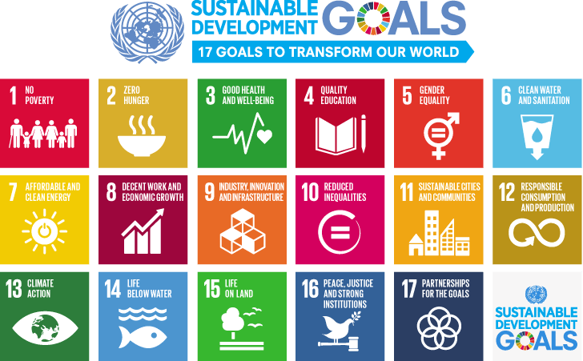
Introduction to the SDGs
Notes:
I know Indonesia has fully embraced the SDGs, which are designed to provide a "blueprint to achieve a better and more sustainable future for all." Set in 2015 by the United Nations General Assembly, the SDGs and intended to be achieved by the year 2030.
But in fact, achieving sustainable development requires that all SDGs are achieved.
And for those of us working in areas of sustainable development, it quickly becomes clear just how interconnected the goals.are.
Today, I will discuss just some of the linkages between SDG 7: Affordable and Clean Energy, and other SDGs.

Slide 4
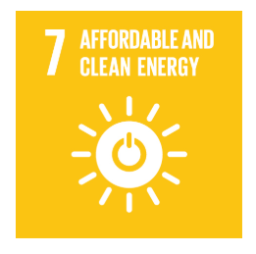
SDG7 focuses on ensuring access to affordable, reliable, sustainable and modern energy for all.
Sustainable energy will play a crucial role for closing the gap to mitigation target of 1.5 degrees.
Notes:
SDG 7 focuses on Ensuring access to affordable, reliable, sustainable and modern energy for all.
Sustainable energy will play a crucial role in the next decade for achievement of 2030 Agenda and for closing the gap to climate change mitigation targets (ofwell below 2°C and aiming for 1.5°C) defined by the Paris Agreement.

Slide 5
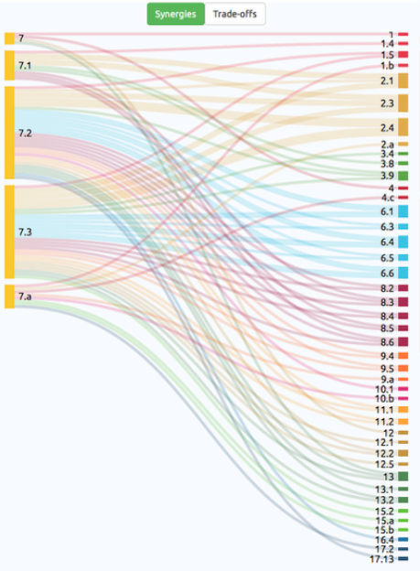
SDG 7 Interlinkages
SDG 7 can be considered an “enabling factor” for the implementation of the other SDGs.
In particular SDG 6, SDG 8, SDG 9, SDG 11, SDG 12, SDG 13
(European University Institute, 2018).
Source: European Commission, 2019. p14
Notes:
SDG 7 can be considered an enabler to achieve the other SDGs on poverty eradication, gender equality, climate change, food security, health, education, sustainable cities and communities, clean water and sanitation, jobs, innovation, transport, and refugees and other situations of displacement
The image here comes from a recent report from the European Commission that explores the interlinkages and policy coherence for the implementation of the SDGs, and I think what’s incredibly powerful about it is it shows how each of the SDG 7 indicators links to other SDGs.
In fact, achieving SDG 7 plays a critical enabling factor for the achievement of the other SDGs. In other words, if we don’t embrace the clean energy transition, we cannot achieve sustainable development.

Slide 6

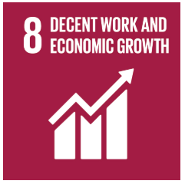
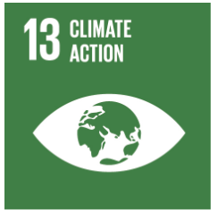
The transformation of the world’s energy systems is already underway, though accelerated action is needed to capitalise on this momentum to support achievement of SDG7.
Notes:
Given it would take us about a week to explore all of these interlinkages, today I’ll focus on just 3 that I hope are particularly interesting and relevant for Indonesia.
I’ll focus today on the connection between SDG7 and SDGs 3 (Health), 8 (Economy & jobs) and 13 (climate action).
SDG 7 is within reach. The transformation of the world’s energy systems is already under way and is being accelerated by advances in technologies, rapid cost declines and concerns for energy security.
Capitalizing on this momentum to achieve SDG 7 and the benefits it brings to the achievement of other SDGs requires strengthened political will, increased levels of investment and action by all stakeholders to scale up the deployment of renewable energy technologies, increase energy efficiency and make clean energy more affordable than ever for the benefit of all
However, with a holistic approach to policy making, the global energy transition can transorm our world, fueling economic growth, creating employment opportunities, and enhancing welfare benefits.
https://sustainabledevelopment.un.org/content/documents/18041SDG7_Policy_Brief.pdf

Slide 7
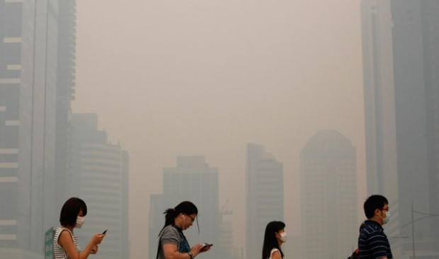
Shifting to clean energy is essential for health & wellbeing
Notes:
I’m going to start briefly with SDG 3 - Good Health and Wellbeing.
I couldn’t be here in Jakarta talking about the link between clean energy and the SDGs without touching on the obvious - human health.
All fossil fuels emit carbon dioxide and other harmful air pollutants when burned. These emissions lead to a wide variety of public health and environmental costs that are borne at the local, regional, national, and global levels.
The connection between burning fossil fuels and direct impacts on human health is well understood.
And here we are in Jakarta, second only to New Delhi with the highest total suspended particulate (TSP) caused in large part by emissions from vehicle operation - but I don’t need to tell you this, you’re breathing this air every day!.
Air pollution negatively impacts society by creating a myriad of severe health problems, with an estimated 60% of Jakarta residents suffering some form of air pollution-related illness and diseases.
And the economic costs of these health outcomes are significant.
A 2012 Indonesian Ministry of Environment cost-benefit analysis (CBA) study reported the cost of air pollution illnesses in Jakarta alone was US $535 million in 2010.
In addition to direct health costs, the detrimental health outcomes caused by air pollution also have broader economic implications in reduced economic productivity from sick days and premature deaths.

Slide 8
Prioritising low carbon infrastructure can deliver US$26 trillion of additional value to the global economy by 2030, while creating 65 million new jobs.
(Global Commission on the Economy, 2018)
Notes:
Conversely A shift to clean energy can boost GDP.
A recent study by the Global Commission on the Economy and Climate found that the world will invest $90 trillion in new infrastructure between now and 2030.
By choosing low carbon infrastructure over carbon intensive infrastructure, that same $90 trillion could deliver an additional US$26 trillion in economic value to the global economy, while also creating more than 65 million new low carbon jobs.

Slide 9
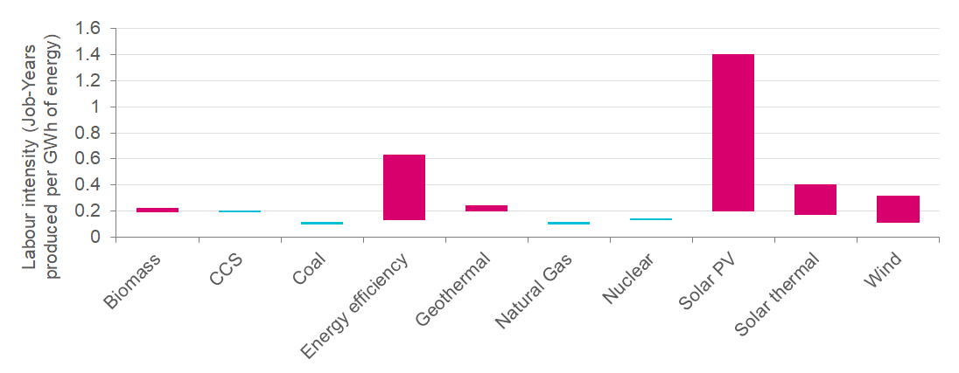
Renewable energy creates jobs
Note: Bars reflect the lower and upper bound of jobs created. Source: Vivid Economics, Wei, Patadia and Kammen (2010)
Notes:
For governments looking to create jobs, RE is a clear winner over traditional energy sources.
This graph compares the labour intensity in job years created per GWh of energy produced. The higher the bar, the more jobs created.
Renewable energy is typically more labour-intensive than traditional fossil fuels, with renewables and energy efficiency far outstripping fossil fuels in their labour intensity.
In other words, prioritising RE technology manufacturing and deployment, coupled with energy efficiency, creates lots more jobs than business-as-usual.
Renewable energy employed 11 million people globally in 2018, and about 60% of those jobs are based in Asia Pacific.

Slide 10
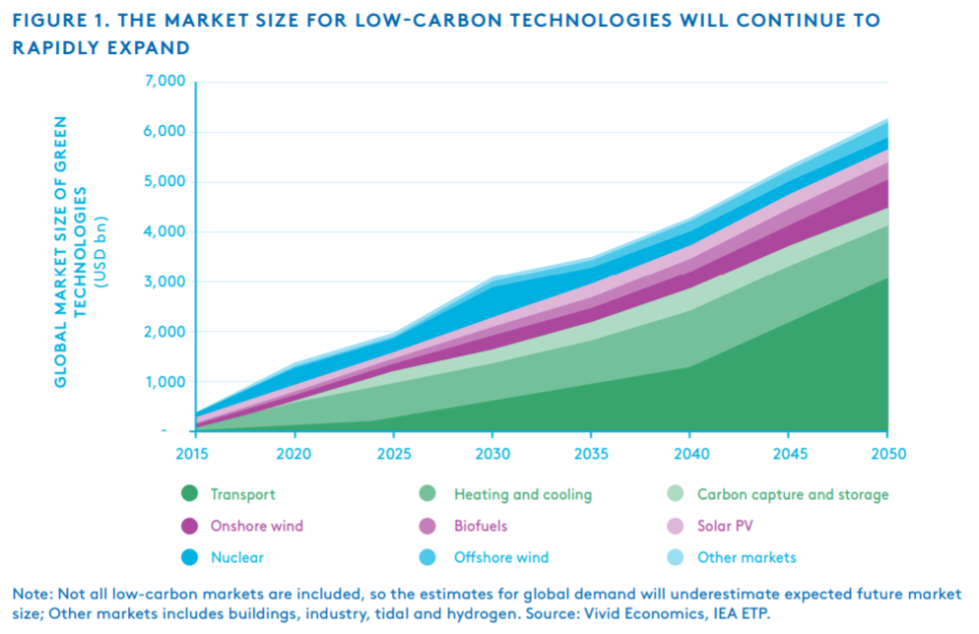
The global market size for low carbon technologies will continue to rapidly expand __________________________
Notes:
Job creating is usually tied to investment, and low carbon technologies are the gold rush of the 21st century.
In recent research we completed with UK think tank Vivid Economics on low carbon industrial strategies for Indonesia, Vietnam and the Philippines, we’ve conservatively estimated a 6-fold increase in the value of global low carbon technology markets from around US$1 trillion today to more than $6 trillion in just 3 decades.
And it’s a conservative estimate, because it only includes technologies that we could get reliable data on. It clearly does not include the new, emerging, and as yet undiscovered technologies that will power our planet in future.

Slide 11
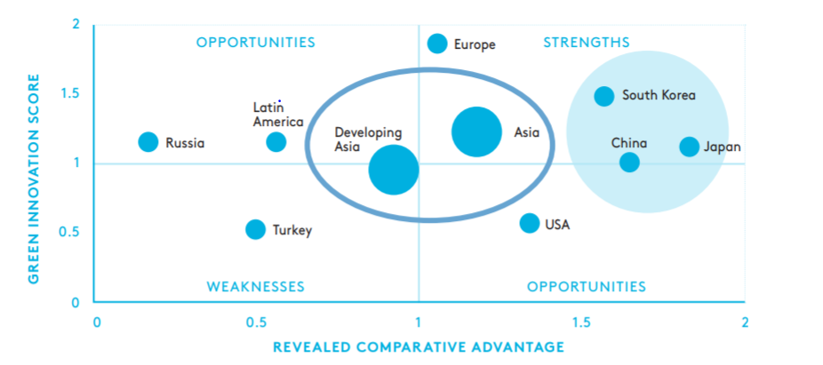
Asia is already ahead in the global green race
Notes:
Here’s where the story gets even more interesting.
Explain how to read graph - Y axis shows how good a country is at innovation in various green technologies (if above middle line, better than global average at innovation), X axis shows how competitive a country is at producing and exporting that green technology (if right of middle line, better than global average at export competitiveness),
To have a clear comparative advantage, countries are typically good at both innovation and export in a given technology - you want to be up here in the top, right corner.
Asia as a whole is already ahead in the global green race - more innovative than US, and more competitive than EU.
Not surprisingly, this is driven by major Asian economies such as South Korea, Japan and China.
When we split these 3 countries out, we can see that Developing Asia is on the cusp of competitiveness, and is well placed to take advantage of the large anticipated growth in the demand for low-carbon technologies with its combination of highly skilled and low cost labour, increasing investment attractiveness and geographical proximity to market leaders.
And what this graph shows is that, if you want to be a winner in the low carbon race, being an Asian economy gives you a clear head start.
Countries that get a head start in developing low-carbon technologies and manufacturing hubs today will be the major economies of tomorrow. They will help lead the global transition towards clean and sustainable industrial growth. Much like the last wave of globalisation, there will once again be clear first mover advantage.

Slide 12
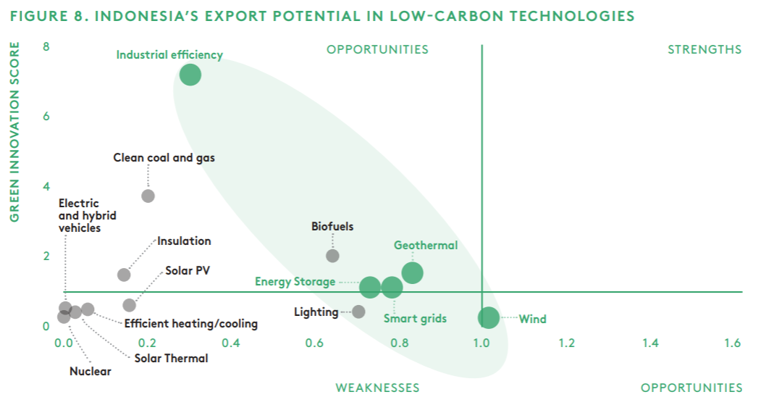
Indonesia has clear opportunities in Industrial energy efficiency, energy storage, geothermal and wind.
Notes:
We found the story for Indonesia showed some surprising results.
Indo innovates 8 x more than the global average in Industrial EE. You guys are really really really good at inventing energy efficiency technologies for industry. Room for improvement in implementing them...
The analysis also showed an emerging opportunity for energy storage, based on your country’s abundant nickel and bauxite reserves. I think this opportunity would be more pronounced if we’d been able to include more recent data, given the increasing policy focus on capturing this opportunity.
And here’s another surprising one - Indonesia already produces wind components more competitively than global average. In fact Indonesia produces wind towers at one fifth the cost of China, despite having very little installed domestic capacity.
So, not only can renewable energy technologies attract investment, which in turn creates jobs and additional economic value, but by harnessing opportunities to build innovation and manufacturing capability, RE can also help to diversify Indonesia’s economy and position it for sustained and sustainable economic growth into the future.

Slide 13
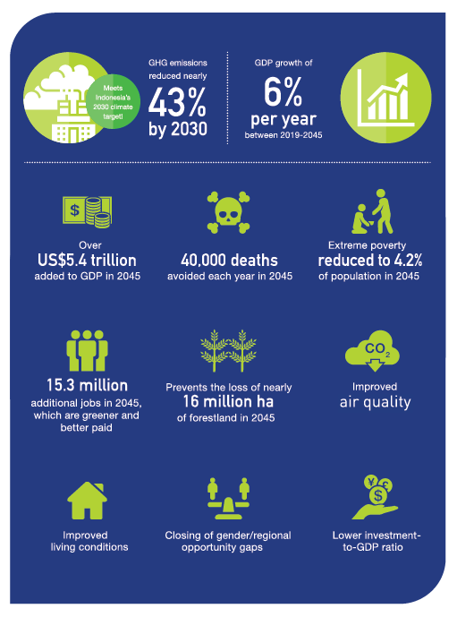
A Strong, Equitable, Low Carbon Economy for Indonesia
Benefits of LCDI High Scenario compared with Base case
“Indonesia can deliver real economic and social progress, while preserving its natural resources and biodiversity. This is the sustainable and inclusive growth story for the 21st century”
Source: Low-carbon Development Initiative: A paradigm
shift towards a green economy in Indonesia
Notes:
Recent analysis by Indonesian Ministry of Planning (BAPPENAS) finds that the most significant opportunity for sustaining Indonesia’s economic growth over the long term is a low-carbon development trajectory.
In fact, the report finds that a more ambitious approach to climate action and sustainable development, delivers gains to the Indonesian economy, in terms of GDP growth, jobs growth and poverty alleviation.
In contrast, a continuation with business-as-usual will see Indonesia’s rate of GDP growth beginning to decline almost immediately due to depletion of the country’s natural capital reserves and the environmental and health impacts of fossil fuel combustion
It demonstrates that for sustained economic growth, the shift to low carbon is not a future wish for Indonesia, but an immediate need.

Slide 14
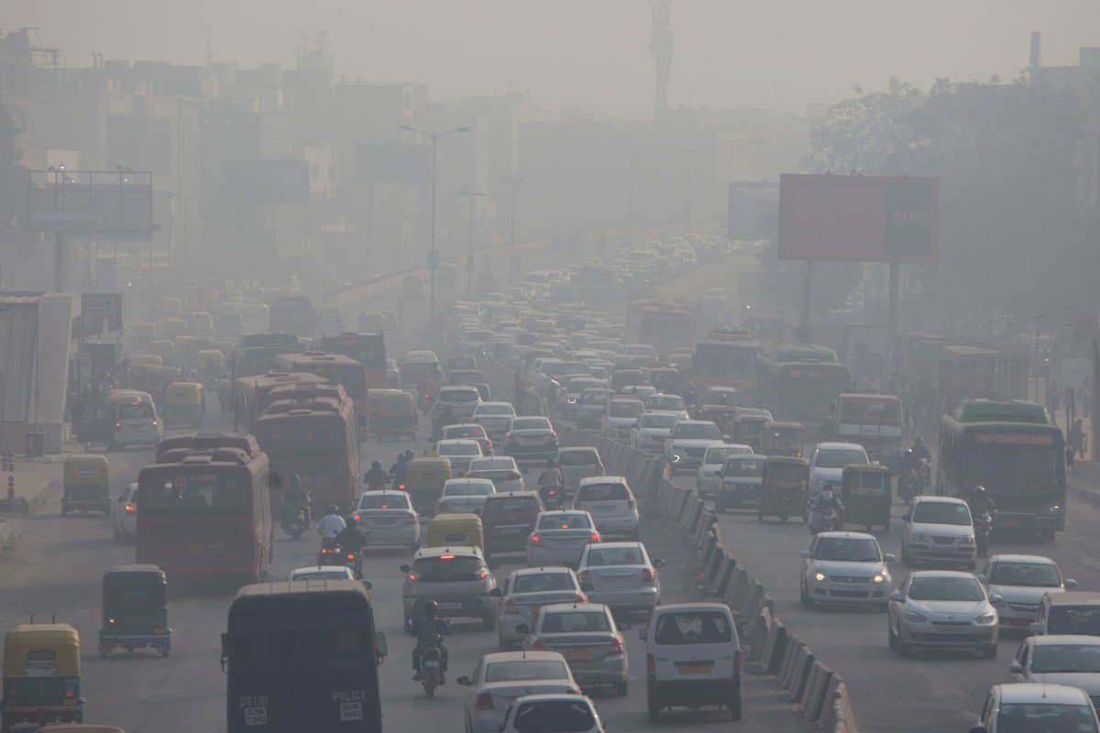
“The global climate crisis is
arguably the biggest challenge
human civilisation faces in the
21st century, with the Asia and
Pacific region at the heart of it
all.”
Bambang Susantono
Vice-president for Knowledge Management and
Sustainable Development, ADB
Notes:
And coming from an organisation with ‘Climate’ in the name, need to touch on the links between SDG 7 and Climate Action.
ADB: “The global climate crisis is arguably the biggest challenge human civilization faces in the 21st century, with the Asia and Pacific region at the heart of it all.”
Globally, burning fossil fuels for energy and heat is the single largest source of greenhouse gas emissions, and in Indonesia, the second largest source after land use change and forestry.
Climate change cannot be solved without shifting to clean energy.
And the implications of not solving it are unimaginable.
I’m sure you all saw the Jakarta Post article last week on the risk of rising sea levels, which are expected to displace 23 million Indonesians living in coastal cities by 2050.

Slide 15
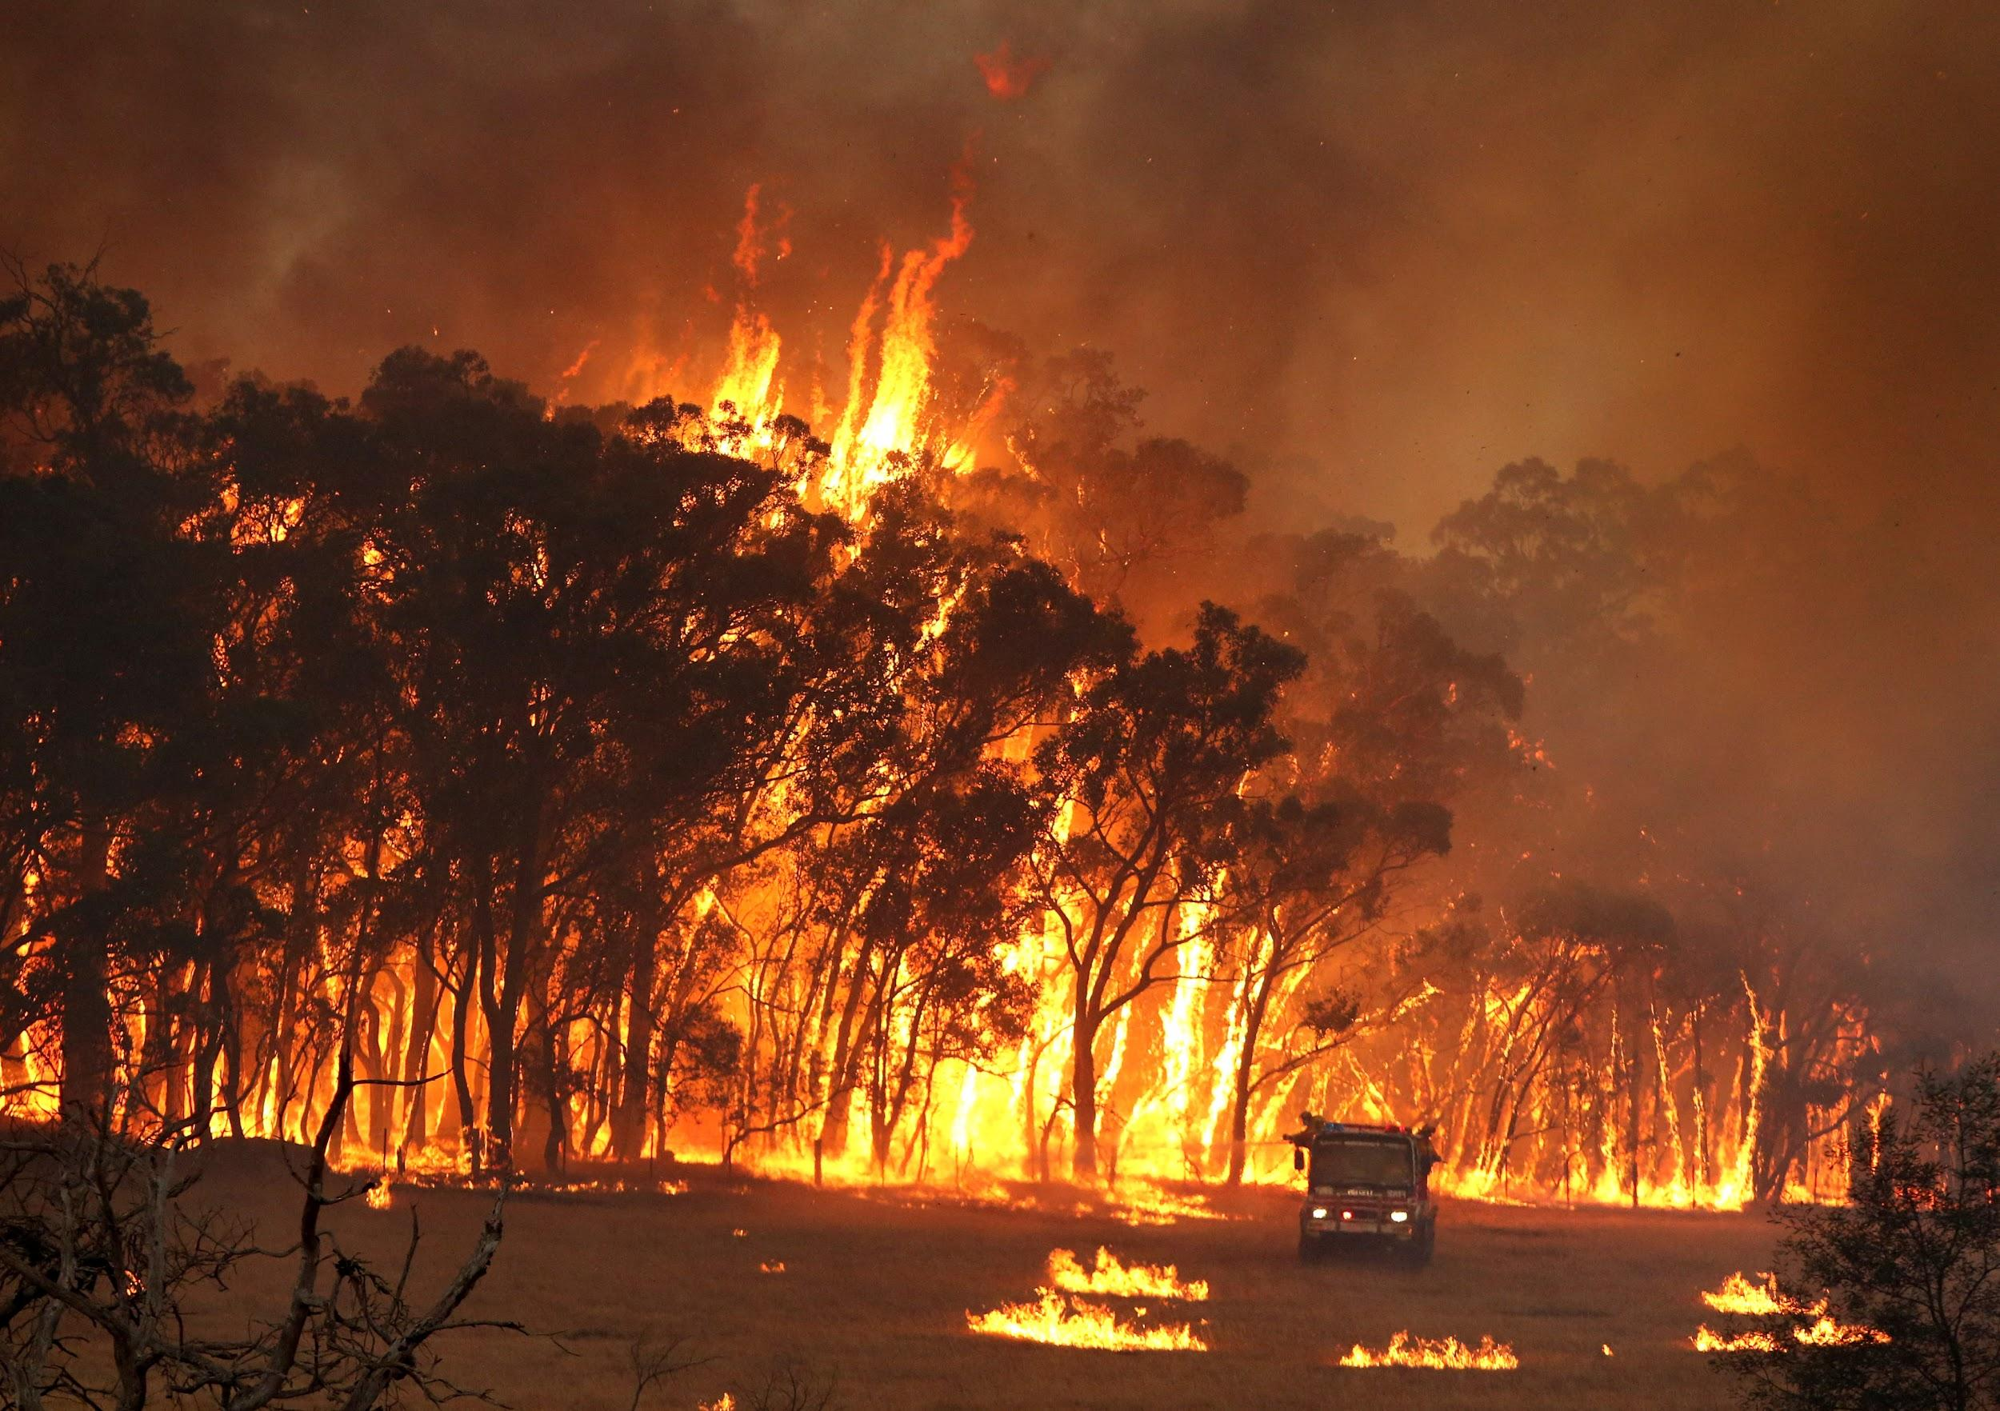
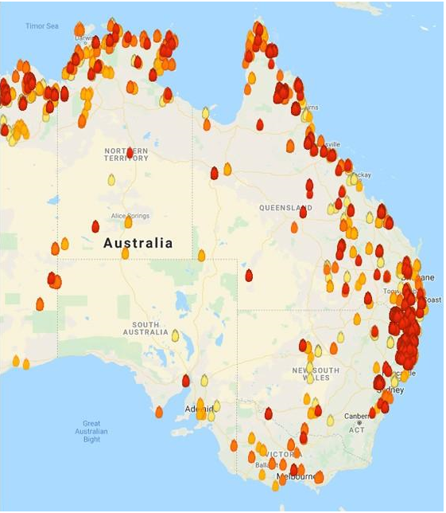
Notes:
And here’s a snapshot from my country, which as you can see from the graph on the right, is pretty much all on fire.
The fires we are experiencing are unprecedented. In the state of NSW alone, more than 1 million hectares is currently burning.
These catastrophic fires are increasing in frequency and intensity, which can be directly linked to the impacts of climate change.

Slide 16
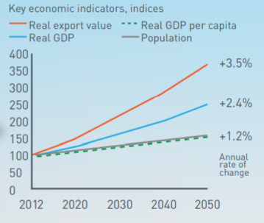
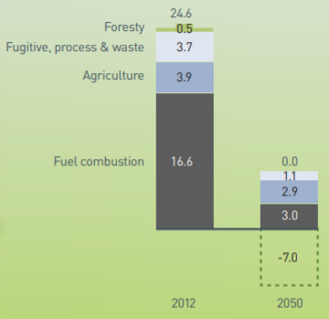
An Australian Case Study - it’s economically feasible to transition the world’s most emissions-intensive economy to net-zero
Notes:
But even for highly exposed and emissions-intensive economy such as Australia, the transition to a low carbon future is both achievable and economically beneficial.
In fact, the transition story for Australia is a surprisingly positive one.
In our Pathways to Deep Decarbonisation in 2050, which was part of the global Deep Decarbonisation Pathways Project which we participated in along with our Indonesian colleagues from ITB and Bogor University, we showed that Australia could transition from the world’s most emissions-intensive economy to net zero emissions by 2050 with virtually no impact on our economic growth.
And this was without considering the economic opportunities from the extraordinary natural resources that Australia has that will have high value in a low carbon future.
This work has informed net zero by 2050 plans that we have worked on with Australia’s most emissions-intensive states, and today we find ourselves in the unique position of having 8/8 sub-national governments who have set net zero by 2050 targets, despite the policy position on climate change of our national government.

Slide 17
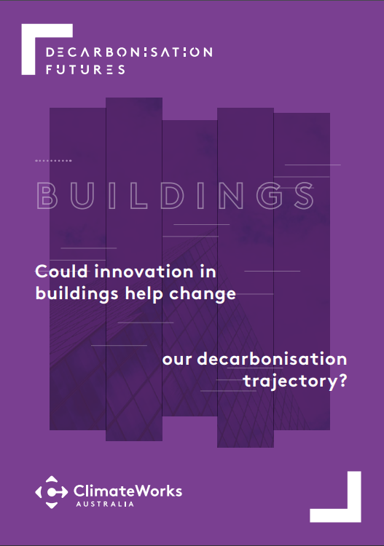
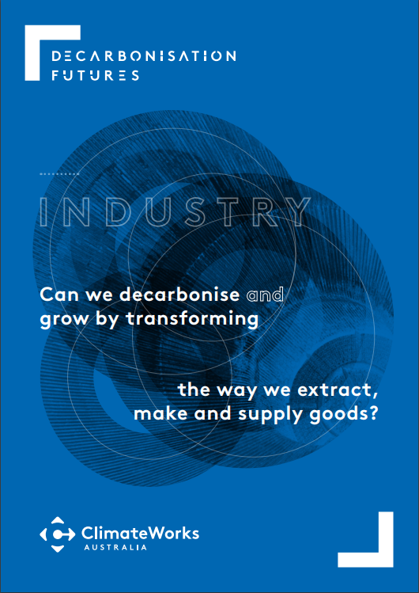
ClimateWorks is now this analysis with Decarbonisation Futures
Analyses new technologies, social changes and business models to assess how innovation can help us get to net zero emissions sooner.
Highlights risks from failing to proactively adapt to economic and societal changes.
Notes:
Currently updating this research in a new Decarbonisation Futures report, which analyses new technologies, social changes and business models that were deliberately excluded from the original Pathways work. We will assess how such innovation can help us get to net zero emissions sooner, demonstrating the opportunities if policy and investment planning take next generation technologies into account, instead of basing decisions on last decade technologies. This research will also highlight the risks associated with failing to proactively adapt to likely economic and societal changes such as locking-in unnecessary emissions with outdated policy settings.
Our new work will analyse the potential of innovative technologies along with social and economic practices, and further demonstrate the economic benefits for Australia of achieving the Paris Agreement of stabilising global temperature rise at well below 2°C and aiming for 1.5°C.

Slide 18
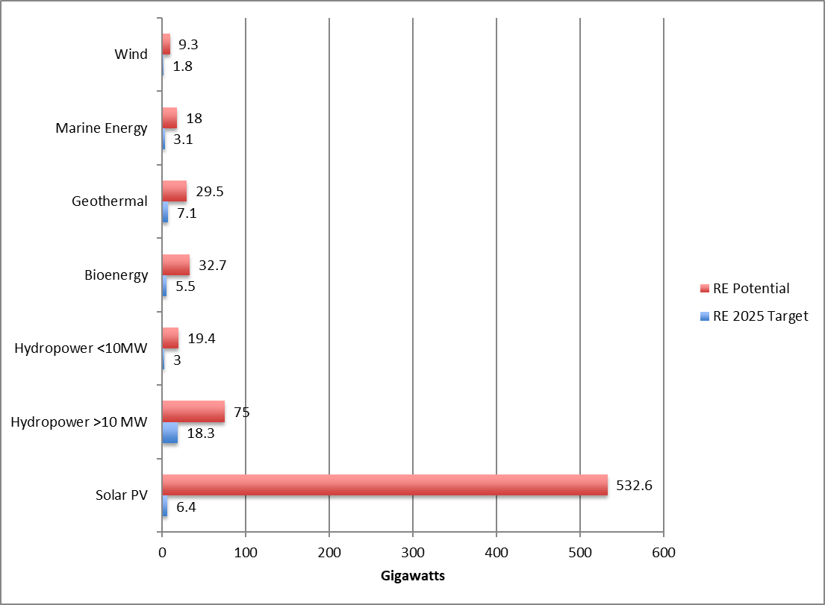
Indonesia has excellent renewable energy resources.
Indonesia’s Renewable Energy Power Potential by Technology
Indonesia is home to abundant renewable energy sources such as solar, wind, water, bioenergy and geothermal.
These remain largely untapped.
Source: IRENA, 2017.
Notes:
But like Australia, a transition towards clean, cheap energy using indigenous energy sources is possible in Indonesia.
Although Indonesia is home to abundant renewable energy sources, such as solar, wind, water (hydro), geothermal, sea currents and biomass, the country’s renewable energy potential remains largely untapped.
As I’ve highlighted, shifting to clean energy can deliver multiple benefits for Indonesia - it can improve health outcomes, which in turn delivers economic productivity benefits; it can create new industries that can diversify the Indonesian economy and enhance resilience in the global transition away from fossil fuels, and it can help Indonesia to play its role in the global effort to solve climate change.
The sustainable development benefits of shifting to clean energy mean we are all winners in the clean energy transition. But if we fail to act, if we fail to be bold and ambitious in the face of the enormous challenge we collectively face, then we all lose in the end.
Thank you.

Slide 19
For further information:
Meg Argyriou
Head of International Programs
meg.argyriou@climateworksaustralia.org
www.climateworksaustralia.org/international-program

